Slide 1
CS3591 COMPUTER NETWORKS
Dr.M.Kaliappan
Professor
Dept. of Artificial Intelligence and Data Science

Slide 2
Vision
To impart international quality education, promote collaborative research and graduate industry-ready engineers in the domain of Artificial Intelligence and Data Science to serve the society.
Mission
Excel in Teaching-Learning process and collaborative Research by the use of modern infrastructure and innovative components.
Establish an Artificial Intelligence and Data Science based centre of excellence to prepare professional technocrats for solving interdisciplinary industry problems in various applications
Motivate students to emerge as entrepreneurs with leadership qualities in a societal centric programme to fulfil Industry and community needs with ethical standards

Slide 3
Program Specific Outcomes (PSOs)
After successful completion of the degree, the students will be able to:
PSO 1: To apply analytic technologies to arrive at actionable foresight, Insight, hindsight from data for solving business and engineering problems
PSO 2: To create, and apply the techniques of AI and Data Science to forecast future events in the domain of Healthcare, Education, and Agriculture, Manufacturing, Automation, Robotics, Transport, etc
PSO 3: To enrich the critical thinking skills in emerging technologies such as Hybrid Mobile application development, cloud technology stack, and cyber-physical systems with mathematical aid to foresee the research findings and provide the solutions

Slide 4
Program Educational Objectives (PEOs)
After successful completion of the degree, the students will be able to
PEO 1. Apply Artificial Intelligence and Data Science techniques with industrial standards and pioneering research to solve social and environment-related problems for making a sustainable ecosystems.
PEO 2. Excel with professional skills, fundamental knowledge, and advanced futuristic technologies to become Data Scientists, Data Analyst Managers, Data Science leaders, AI Research Scientists, or Entrepreneurs

Slide 5
CS3591 COMPUTER NETWORKS L T P C
3 0 2 4
COURSE OBJECTIVES:
To understand the concept of layering in networks.
To know the functions of protocols of each layer of TCP/IP protocol suite.
To visualize the end-to-end flow of information.
To learn the functions of network layer and the various routing protocols
To familiarize the functions and protocols of the Transport layer

Slide 6
UNIT I INTRODUCTION AND APPLICATION LAYER 10
Data Communication - Networks – Network Types – Protocol Layering – TCP/IP Protocol suite – OSI Model – Introduction to Sockets - Application Layer protocols: HTTP – FTP – Email protocols (SMTP - POP3 - IMAP - MIME) – DNS – SNMP
UNIT II TRANSPORT LAYER 9
Introduction - Transport-Layer Protocols: UDP – TCP: Connection Management –Flow control - Congestion Control - Congestion avoidance (DECbit, RED) – SCTP – Quality of Service
UNIT III NETWORK LAYER 7
Switching: Packet Switching - Internet protocol - IPV4 – IP Addressing – Subnetting - IPV6, ARP, RARP, ICMP, DHCP
UNIT IV ROUTING 7
Routing and protocols: Unicast routing - Distance Vector Routing - RIP - Link State Routing – OSPF – Path-vector routing - BGP - Multicast Routing: DVMRP – PIM.
UNIT V DATA LINK AND PHYSICAL LAYERS 12
Data Link Layer – Framing – Flow control – Error control – Data-Link Layer Protocols – HDLC – PPP - Media Access Control – Ethernet Basics – CSMA/CD – Virtual LAN – Wireless LAN (802.11) - Physical Layer: Data and Signals - Performance – Transmission media- Switching – Circuit Switching.
45 PERIODS

Slide 7
PRACTICAL EXERCISES: 30 PERIODS
1. Learn to use commands like tcpdump, netstat, ifconfig, nslookup and traceroute. Capture ping and trace route PDUs using a network protocol analyzer and examine.
2. Write a HTTP web client program to download a web page using TCP sockets.
3. Applications using TCP sockets like: a) Echo client and echo server b) Chat
4. Simulation of DNS using UDP sockets.
5. Use a tool like Wireshark to capture packets and examine the packets
6. Write a code simulating ARP /RARP protocols.
7. Study of Network simulator (NS) and Simulation of Congestion Control Algorithms using NS.
8. Study of TCP/UDP performance using Simulation tool.
9. Simulation of Distance Vector/ Link State Routing algorithm.
10. Simulation of an error correction code (like CRC)
COURSE OUTCOMES:
At the end of this course, the students will be able to:
CO 1: Explain the basic layers and its functions in computer networks.
CO 2: Describe the basics of data flows from one node to another.
CO 3: Analyze routing algorithms.
CO 4: Describe protocols for various functions in the network.
CO 5: Analyze the working of various application layer protocols.
TOTAL:75 PERIODS

Slide 8
TEXT BOOKS
James F. Kurose, Keith W. Ross, Computer Networking, A Top-Down Approach Featuring the Internet, Eighth Edition, Pearson Education, 2021.
Behrouz A. Forouzan, Data Communications and Networking with TCP/IP Protocol Suite, Sixth Edition TMH, 2022
REFERENCES
Larry L. Peterson, Bruce S. Davie, Computer Networks: A Systems Approach, Fifth Edition, Morgan Kaufmann Publishers Inc., 2012.
William Stallings, Data and Computer Communications, Tenth Edition, Pearson Education, 2013.
Nader F. Mir, Computer and Communication Networks, Second Edition, Prentice Hall, 2014.
Ying-Dar Lin, Ren-Hung Hwang, Fred Baker, “Computer Networks: An Open Source Approach”, McGraw Hill, 2012

Slide 9
Introduction
Data refers to information presented in whatever form is agreed upon by the parties creating and using the data.
Data communications are the exchange of data between two devices via some form of transmission medium such as a wire cable or wireless.
The effectiveness of a data communications system depends on four fundamental characteristics:
Delivery,
Accuracy,
Timeliness, and
Jitter.

Slide 10
1. Delivery. The system must deliver data to the correct destination. Data must be received by the intended device or user and only by that device or user.
2. Accuracy. The system must deliver the data accurately. Data that have been altered in transmission and left uncorrected are unusable.
3. Timeliness. The system must deliver data in a timely manner. Data delivered late are useless. In the case of video and audio, timely delivery means delivering data as they are produced, in the same order that they are produced, and without significant delay. This kind of delivery is called real-time transmission.
4. Jitter. Jitter refers to the variation in the packet arrival time. It is the uneven delay in the delivery of audio or video packets. For example, let us assume that video packets are sent every 30 ms. If some of the packets arrive with 30-ms delay and others with 40-ms delay, an uneven quality in the video is the result

Slide 11
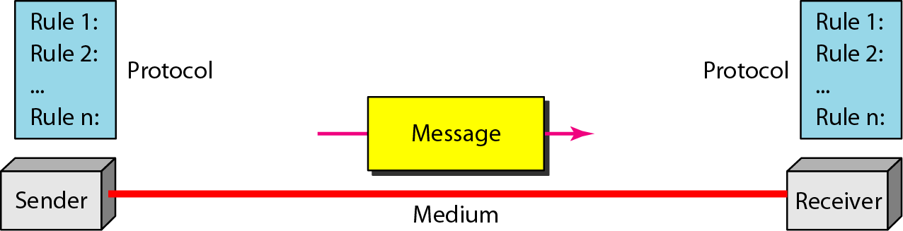
Components

Slide 12
Message. The message is the information (data) to be communicated. Popular
forms of information include text, numbers, pictures, audio, and video.
Sender. The sender is the device that sends the data message. It can be a computer,workstation, telephone handset, video camera, and so on
Receiver. The receiver is the device that receives the message. It can be a computer, workstation, telephone handset, television, and so on.
Transmission medium. The transmission medium is the physical path by which a message travels from sender to receiver. Some examples of transmission media
include twisted-pair wire, coaxial cable, fiber-optic cable, and radio waves.
Protocol. A protocol is a set of rules that govern data communications.Without a protocol, two devices may be connected but not communicating, just as a person speaking French cannot be understood by a person who speaks only Japanese.

Slide 13
Data Representation
Information today comes in different forms such as
Text,
Numbers,
Images,
Audio, and
Video.

Slide 14
Data Representation..
Text
In data communications, text is represented as a bit pattern, a sequence of bits (0s or 1s). Different sets of bit patterns have been designed to represent text symbols. Each set is called a code, and the process of representing symbols is called coding.
Today, the coding system is called Unicode, which uses 32 bits to represent a symbol or character used in any language in the world. The American Standard Code for Information Interchange (ASCII), developed some decades ago in the United States, now constitutes the first 127 characters in Unicode and is also referred to as Basic Latin.

Slide 15
Data Representation
Numbers
Numbers are also represented by bit patterns. However, a code such as ASCII is not used to represent numbers; the number is directly converted to a binary number to simplify mathematical operations.

Slide 16
Data Representation
Images
Images are also represented by bit patterns. In its simplest form, an image is composed of a matrix of pixels (picture elements), where each pixel is a small dot. The size of the pixel depends on the resolution. For example, an image can be divided into 1000 pixels or 10,000 pixels. In the second case, there is a better representation of the image (better resolution), but more memory is needed to store the image.
After an image is divided into pixels, each pixel is assigned a bit pattern. The size and the value of the pattern depend on the image. For an image made of only blackand- white dots (e.g., a chessboard), a 1-bit pattern is enough to represent a pixel.
If an image is not made of pure white and pure black pixels, we can increase the size of the bit pattern to include gray scale. For example, to show four levels of gray scale, we can use 2-bit patterns. A black pixel can be represented by 00, a dark gray pixel by 01, a light gray pixel by 10, and a white pixel by 11.
There are several methods to represent color images. One method is called RGB, so called because each color is made of a combination of three primary colors: red, green, and blue. The intensity of each color is measured, and a bit pattern is assigned to it. Another method is called YCM, in which a color is made of a combination of three other primary colors: yellow, cyan, and magenta

Slide 17
Data Representation
Audio
Audio refers to the recording or broadcasting of sound or music. It is continuous, not discrete. Even when we use a microphone to change voice or music to an electric signal, we create a continuous signal.
Video
Video refers to the recording or broadcasting of a picture or movie. Video can either be produced as a continuous entity (e.g., by a TV camera), or it can be a combination of images, each a discrete entity, arranged to convey the idea of motion

Slide 18
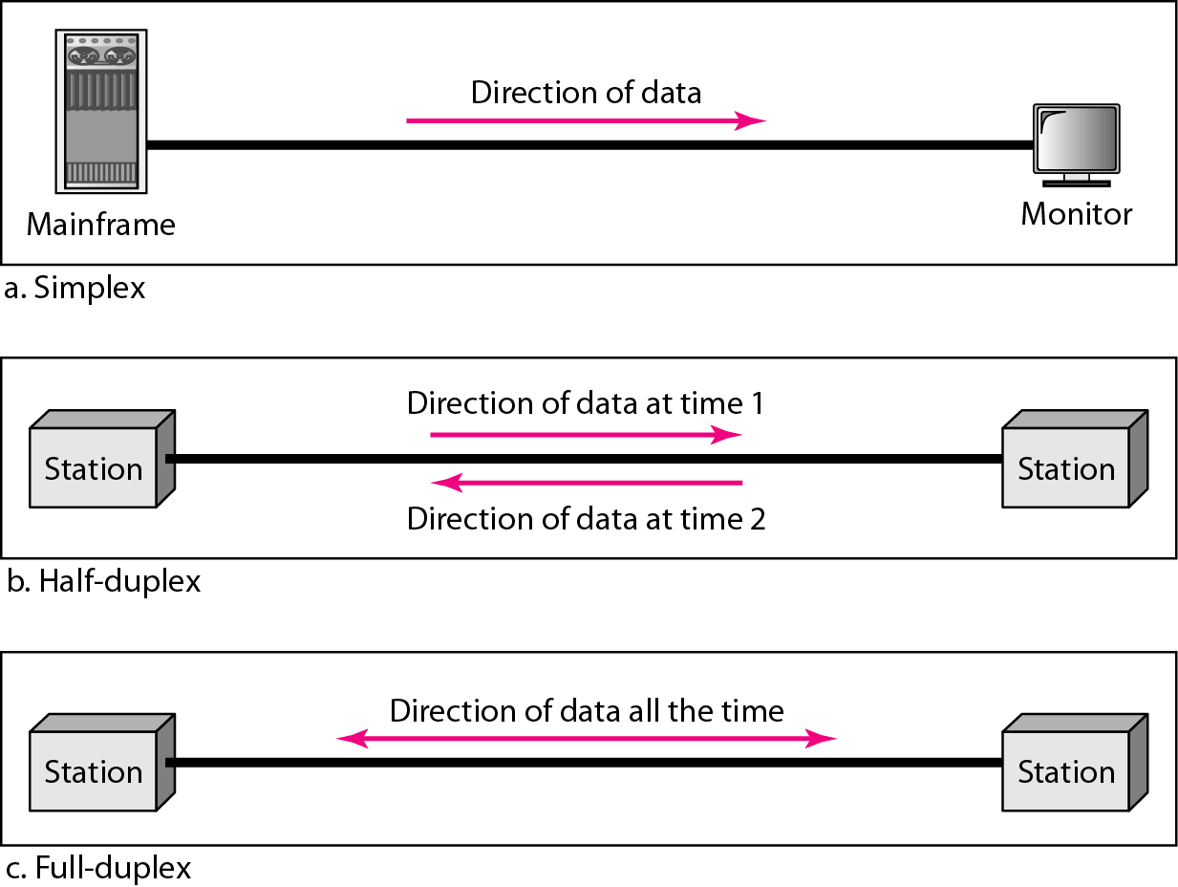
Figure 1.2 Data flow (simplex, half-duplex, and full-duplex)

Slide 19
Simplex:The communication is unidirectional, as on a one-way street. Only one of the two devices on a link can transmit; the other can only receive
Example: Keyboards and traditional monitors are examples of simplex devices.
The keyboard can only introduce input; the monitor can only accept output.
The simplex mode can use the entire capacity of the channel to send data in one direction

Slide 21
Half-Duplex
Each station can both transmit and receive, but not at the same time. When one device is sending, the other can only receive, and vice versa.
The entire capacity of a channel is taken over by whichever of the two devices is transmitting at the time. Walkie-talkies and CB (citizens band) radios are both half-duplex systems.

Slide 22
Full-Duplex
Both stations can transmit and receive simultaneously
Signals going in one direction share the capacity of the link with signals going in the other direction. Sharing can occur in two ways:
Either the link must contain two physically separate transmission paths, one for sending and the other for receiving; or
Capacity of the channel is divided between signals traveling in both directions
Example: Telephone network, Mobile network

Slide 23




















A network is the interconnection of a set of devices capable of communication.
PC
billions of connected computing devices:
hosts = end systems
running network apps
mobile network
server
wireless
laptop
global ISP
smartphone
communication links
devices in a network are connected using wired or wireless transmission media such as cable or air
fiber, copper, radio, satellite
transmission rate: bandwidth
home
network
wireless
links
regional ISP
wired
links
routers
packet switches: forward packets (chunks of data) :routers and switches
Device can also be a connecting device such as a router, which connects the network to other networks,
a switch, which connects devices together, a modem (modulator-demodulator), which changes the form of data, and so on
router
institutional
network
switch
Notes:
23

Slide 24
Network Criteria
A network must be able to meet a certain number of criteria. The most important of these are
Performance,
Reliability, and
Security.

Slide 25
Performance
Performance can be measured Transit time and Response time.
Transit time is the amount of time required for a message to travel from one device to another.
Response time is the elapsed time between an inquiry and a response.
The performance of a network depends
Number of users,
Type of transmission medium,
Capabilities of the connected hardware, and
Efficiency of the software.
Performance is often evaluated by two networking metrics: throughput and delay.
We often need more throughput and less delay.

Slide 26
Reliability
Reliability is measured by the frequency of
failure, the time it takes a link to recover from
a failure.
Security
Network security issues include protecting data from unauthorized access, protecting data from damage and development, and implementing policies and procedures for recovery from data losses.

Slide 27
Physical Structures
Type of Connection
A network is two or more devices connected through links. A link is a communications pathway that transfers data from one device to another.
There are two possible types of connections: point-to-point and multipoint.

Slide 28
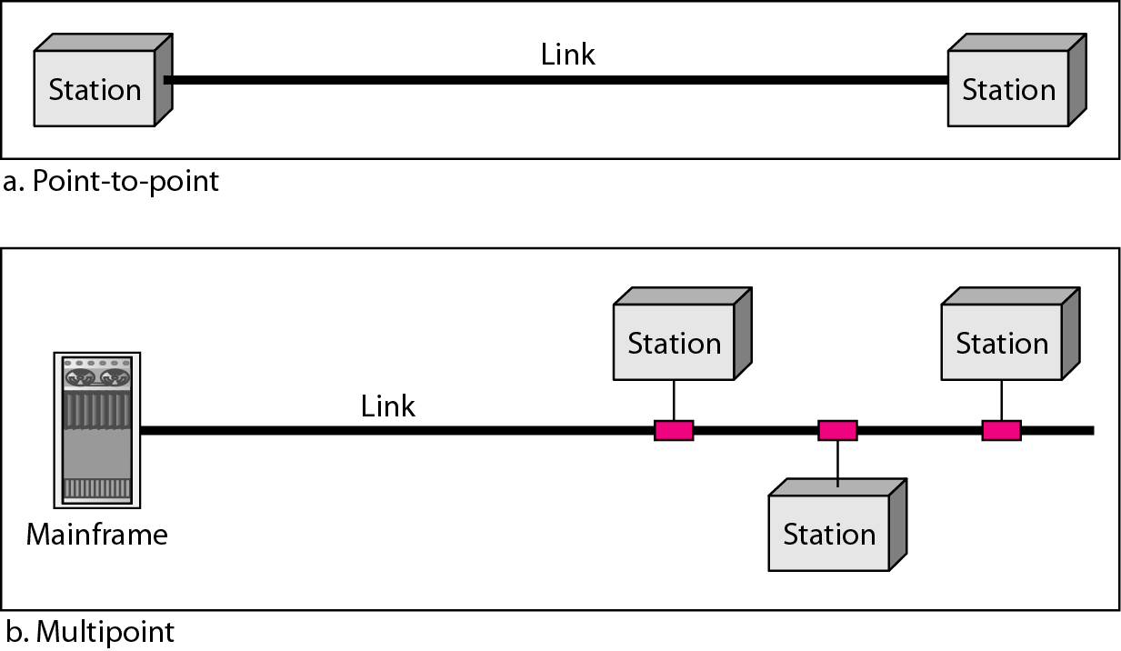
Point-to-Point
A point-to-point connection provides a dedicated link between two devices.
The entire capacity of the link is reserved for transmission between those two devices.

Slide 29
Figure multipoint
Multipoint
A multipoint (also called multidrop) connection is one in which more than two specific devices share a single link.
If several devices can use the link simultaneously, it is a spatially shared connection.
If users must take turns, it is a timeshared connection.

Slide 30
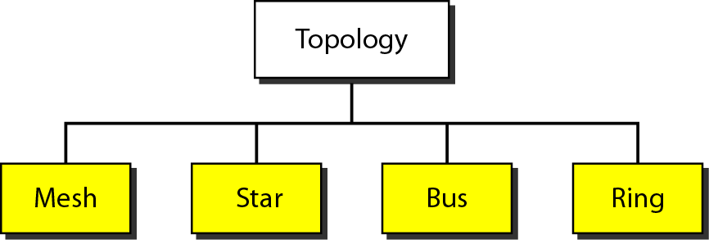
Physical Topology
The term physical topology refers to the way in which a network is laid out physically. Two or more devices connect to a link; two or more links form a topology.
There are four basic topologies possible: mesh, star, bus, and ring.

Slide 31
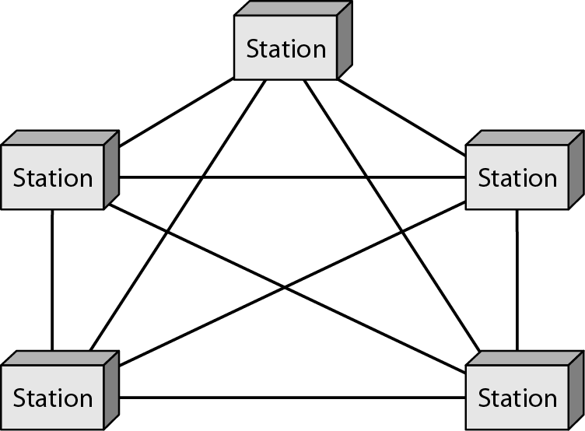
Mesh Topology
Every device has a dedicated point-to-point link to every other device The term dedicated means that the link carries traffic only between the two devices it connects.
To find the number of physical links in a fully connected mesh network with n nodes,
Node 1 must be connected to n – 1 nodes, node 2 must be connected to n – 1 nodes, and finally node n must be connected to n – 1 nodes.
If each physical link allows communication in both directions (duplex mode), we can divide the number of links by 2. we need n (n – 1) / 2 duplex-mode links

Slide 32
Advantages
Use of dedicated links guarantees that each connection can carry its own data load, thus eliminating the traffic problems that can occur when links must be shared by multiple devices.
Second, a mesh topology is robust. If one link becomes unusable, it does not incapacitate the entire system.
Third, there is the advantage of privacy or security.
Finally, point-to-point links make fault identification and fault isolation easy.

Slide 33
Disadvantages
The main of a mesh are related to the amount of cabling and the number of I/O ports required. First, because every device must be connected to every other device, installation and reconnection are difficult.
Second, the sheer bulk of the wiring can be greater than the available space (in walls, ceilings, or floors) can accommodate.
Finally, the hardware required to connect each link (I/O ports and cable) can be prohibitively expensive

Slide 34
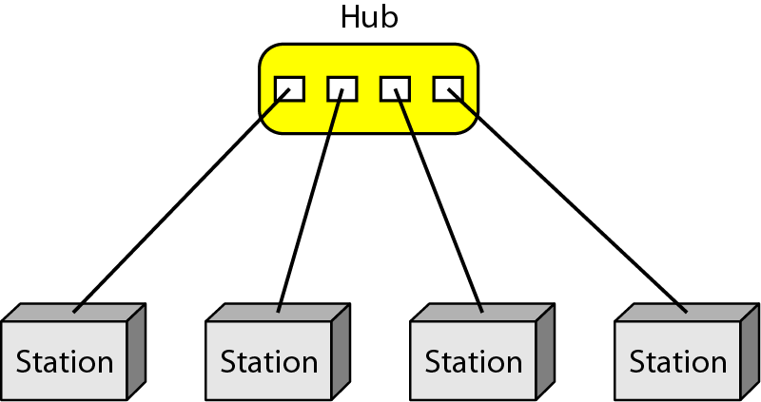
Star Topology
In a star topology, each device has a dedicated point-to-point link only to a central controller. usually called a hub.
The devices are not directly linked to one another. Unlike a mesh topology, a star topology does not allow direct traffic between devices.
The controller acts as an exchange: If one device wants to send data to another, it sends the data to the controller, which then relays the data to the other connected device

Slide 35
Advantage :
Easy to install and reconfigure
If one link fails, only that link is affected. All other links remain active. This factor also lends itself to easy fault identification and fault isolation.
Disadvantage:
One big disadvantage of a star topology is the dependency of the whole topology on one single point, the hub. If the hub goes down, the whole system is dead.

Slide 36
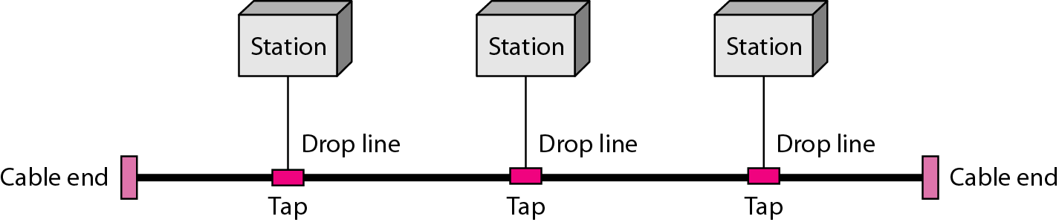
Bus Topology
The preceding examples all describe point-to-point connections.
A bus topology, is multipoint. One long cable acts as a backbone to link all the devices in a network.
As a signal travels along the backbone, some of its energy is transformed into heat. Therefore, it becomes weaker and weaker as it travels farther and farther.

Slide 37
Advantage :
Ease of installation
Bus uses less cabling than mesh or star topologies.
Dis advantage
Adding new devices may therefore require modification or replacement of the backbone.
In addition, a fault or break in the bus cable stops all transmission, even between devices on the same side of the problem

Slide 38
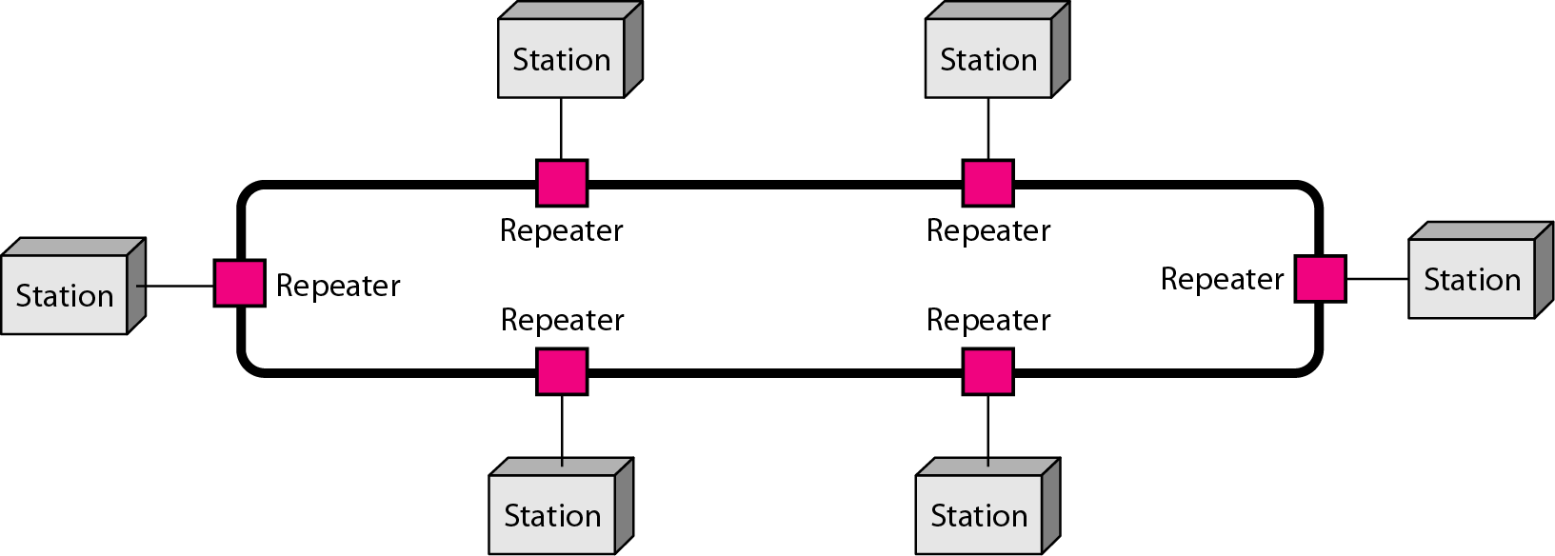
Ring Topology
In a ring topology, each device has a dedicated point-to-point connection with only the two devices on either side of it.
A signal is passed along the ring in one direction, from device to device, until it reaches its destination.
Each device in the ring incorporates a repeater. When a device receives a signal intended for another device, its repeater regenerates the bits and passes them along

Slide 39
To add or delete a device requires changing only two connections.
In addition, fault isolation is simplified.
If one device does not receive a signal within a specified period, it can issue an alarm. The alarm alerts the network operator to the problem and its location.
However, unidirectional traffic can be a disadvantage.
In a simple ring, a break in the ring (such as a disabled station) can disable the entire network. This weakness can be solved by using a dual ring or a switch capable of closing off the break

Slide 40
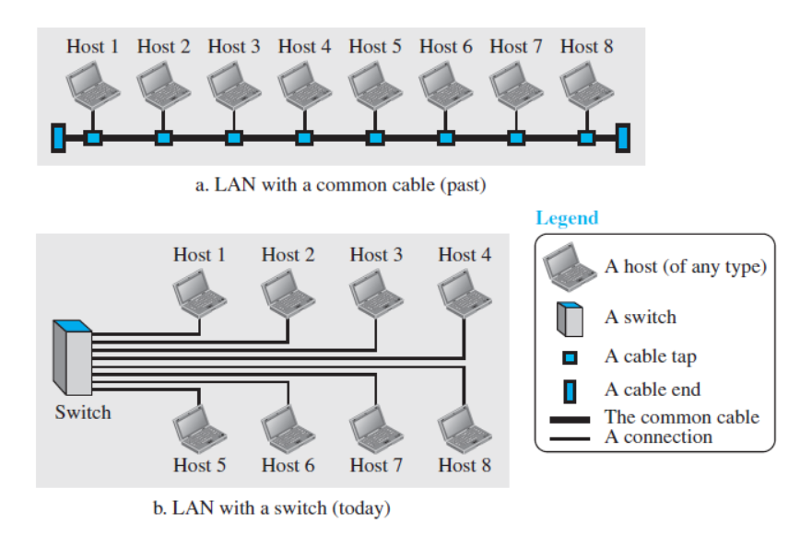
Local Area Network
A local area network (LAN) is usually privately owned and connects some hosts in a single office, building, or campus. Depending on the needs of an organization, a LAN can be as simple as two PCs and a printer in someone’s home office, or it can extend throughout a company and include audio and video devices. Each host in a LAN has an identifier, an address, that uniquely defines the host in the LAN. A packet sent by a host to another host carries both the source host’s and the destination host’s addresses.
In the past, all hosts in a network were connected through a common cable, which
meant that a packet sent from one host to another was received by all hosts. The intended recipient kept the packet; the others dropped the packet. Today, most LANs use a smart connecting switch, which is able to recognize the destination address of the packet and guide the packet to its destination without sending it to all other hosts. The switch alleviates the traffic in the LAN and allows more than one pair to communicate with each
other at the same time if there is no common source and destination among them. Note that the above definition of a LAN does not define the minimum or maximum number of hosts in a LAN. Figure 1.8 shows a LAN using either a common cable or a switch

Slide 41
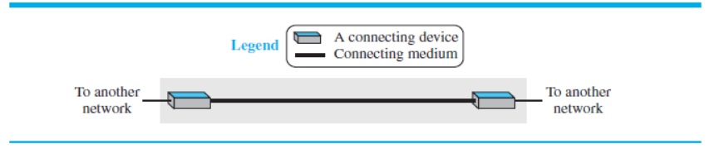
Wide Area Network
A wide area network (WAN) is also an interconnection of devices capable of communication. However, there are some differences between a LAN and a WAN. A LAN is normally limited in size, spanning an office, a building, or a campus; a WAN has a wider geographical span, spanning a town, a state, a country, or even the world. A LAN interconnects hosts;
a WAN interconnects connecting devices such as switches, routers, or modems. A LAN is normally privately owned by the organization that uses it; a WAN is normally created and run by communication companies and leased by an organization that uses it. We see two distinct examples of WANs today: point-to-point WANs and switched WANs.
Point-to-Point WAN
A point-to-point WAN is a network that connects two communicating devices through a transmission media (cable or air). We will see examples of these WANs when we discuss how to
connect the networks to one another

Slide 42
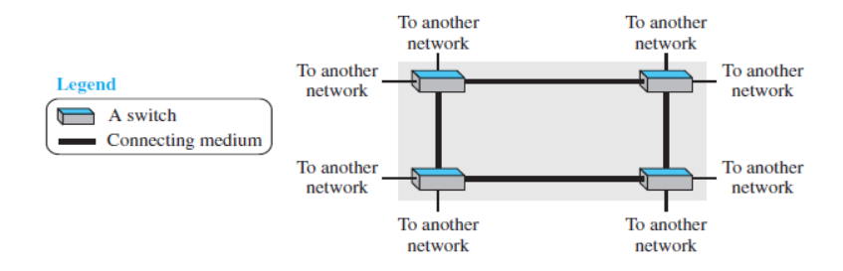
Switched WAN
A switched WAN is a network with more than two ends. A switched WAN, as we will see shortly, is used in the backbone of lobal communication today. We can say that a switched WAN is a combination of several point-to-point WANs that are connected by switches.

Slide 43
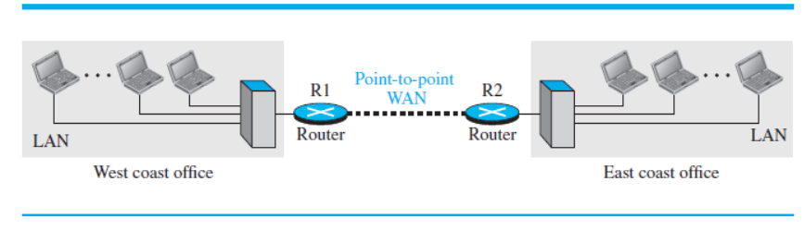
Internetwork
Today, it is very rare to see a LAN or a WAN in isolation; they are connected to one another. When two or more networks are connected, they make an internetwork, or internet.
As an example, assume that an organization has two offices, one on the east coast and the other on the west coast. Each office has a LAN that allows all employees in the office to communicate with each other.
To make the communication between employees at different offices possible, the management leases a point-to-point dedicated WAN from a service provider, such as a telephone company, and connects the two LANs.
Now the company has an internetwork, or a private internet (with lowercase i). Communication between offices is now possible
When a host in the west coast office sends a message to another host in the same office, the router blocks the message, but the switch directs the message to the destination. On the other hand, when a host on the west coast sends a message to a host on the east coast, router R1 routes the packet to router R2, and the packet reaches the destination

Slide 44
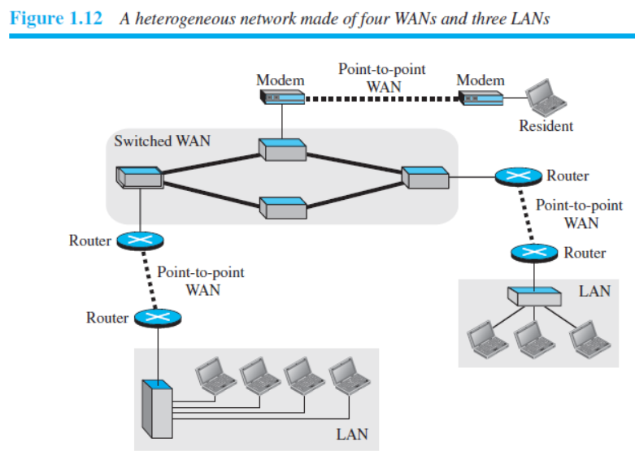

Slide 45
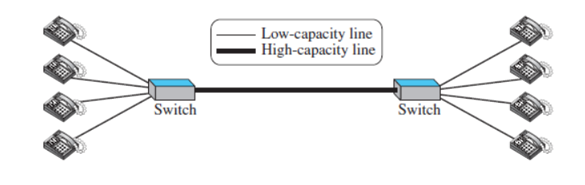
Switching
An internet is a switched network in which a switch connects at least two links together. A switch needs to forward data from a network to another network when required. The two most common types of switched networks are circuit-switched and packet-switched networks. We discuss both next.
Circuit-Switched Network
In a circuit-switched network, a dedicated connection, called a circuit, is always available between the two end systems; the switch can only make it active or inactive.
Figure shows a very simple switched network that connects four telephones to each end. We have used telephone sets instead of computers as an end system because circuit switching was very common in telephone networks in the past, although part of the telephone network today is a packet-switched network line connecting two switches is a high-capacity communication line that can handle four voice communications at the same time; the capacity can be shared between all pairs of telephone sets. The switches used in this example have forwarding tasks but no storing capability

Slide 46
Let us look at two cases. In the first case, all telephone sets are busy; four people at one site are talking with four people at the other site; the capacity of the thick line is fully used. In the second case, only one telephone set at one side is connected to a telephone set at the other side; only one-fourth of the capacity of the thick line is used. This means that a circuit-switched network is efficient only when it is working at its full capacity;
most of the time, it is inefficient because it is working at partial capacity. The reason that we need to make the capacity of the thick line four times the capacity of each voice line is that we do not want communication to fail when all telephone sets at one side want to be connected with all telephone sets at the other side

Slide 47
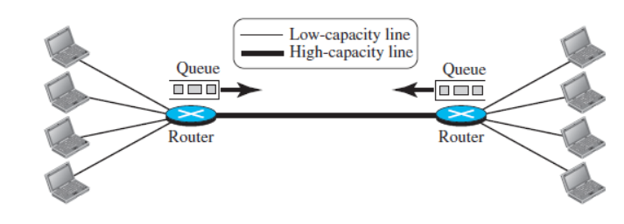
Packet-Switched Network
In a computer network, the communication etween the two ends is done in blocks of data called packets.
In other words, instead of the continuous communication we see between two telephone sets when they are being used, we see the exchange of individual data packets between the two computers. This allows us to make the switches function for both storing and forwarding because a packet is an independent entity that can be stored and sent later.
A router in a packet-switched network has a queue that can store and forward the packet. Now assume that the capacity of the thick line is only twice the capacity of the data line connecting the computers to the routers. If only two computers (one at each site) need to communicate with each other, there is no waiting for the packets.
However, if packets arrive at one router when the thick line is already working at its full capacity, the packets should be stored and forwarded in the order they arrived. The two simple examples show that a packet-switched network is more efficient than a circuit switched network, but the packets may encounter some delays

Slide 48
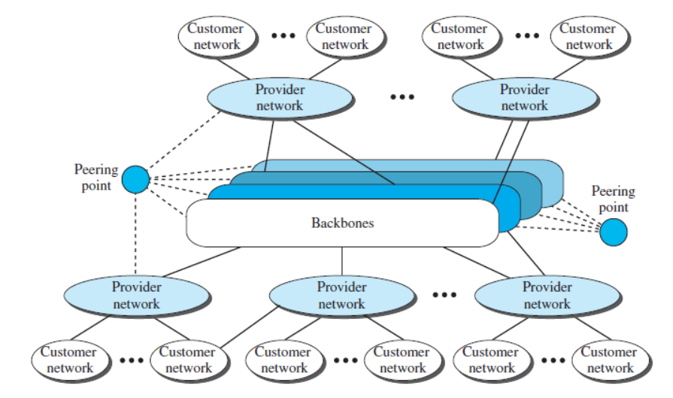
The Internet
As we discussed before, an internet (note the lowercase i) is two or more networks that can communicate with each other. The most notable internet is called the Internet (uppercase I ), and is composed of thousands of interconnected networks.
Figure shows a conceptual (not geographical) view of the Internet. The figure shows the Internet as several backbones, provider networks, and customer networks.
At the top level, the backbones are large networks owned by some communication companies such as Sprint, Verizon (MCI), AT&T, and NTT.

Slide 49
The backbone networks are connected through some complex switching systems, called peering points. At the second level, there are smaller networks, called provider networks, that use the services of the backbones for a fee. The provider networks are connected to backbones and sometimes to other provider networks. The customer networks are networks at the edge of the Internet that actually use the services provided by the Internet.
They pay fees to provider networks for receiving services.
Backbones and provider networks are also called Internet Service Providers (ISPs). The backbones are often referred to as international ISPs; the provider networks are often referred to as national or regional ISPs

Slide 50

How do loss and delay occur?
packets queue in router buffers
packet arrival rate to link (temporarily) exceeds output link capacity
packets queue, wait for turn
packet being transmitted (delay)
A
B
packets queueing (delay)
free (available) buffers: arriving packets
dropped (loss) if no free buffers

Slide 51
Four sources of packet delay
transmission
A
propagation
B
nodal
processing
queueing
d_{nodal} = d_{proc} + d_{queue} + d_{trans} + d_{prop}
d_{proc}: nodal processing
check bit errors
determine output link
typically < msec
d_{queue}: queueing delay
time waiting at output link for transmission
depends on congestion level of router

Slide 52
Four sources of packet delay
transmission
A
propagation
B
nodal
processing
queueing
d_{nodal} = d_{proc} + d_{queue} + d_{trans} + d_{prop}
d_{trans}: transmission delay:
L: packet length (bits)
R: link bandwidth (bps)
d_{trans} = L/R
d_{prop}: propagation delay:
d: length of physical link
s: propagation speed (~2x10⁸ m/sec)
d_{prop} = d/s
d_{trans} and d_{prop}
very different
* Check out the online interactive exercises for more examples: http://gaia.cs.umass.edu/kurose_ross/interactive/
* Check out the Java applet for an interactive animation on trans vs. prop delay
Notes:
52

Slide 53
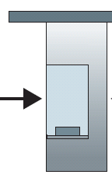
Caravan analogy
100 km
100 km
ten-car
caravan
toll
booth
toll
booth
cars “propagate” at 100 km/hr
toll booth takes 12 sec to service car (bit transmission time)
car ~ bit; caravan ~ packet
Q: How long until caravan is lined up before 2nd toll booth?
time to “push” entire caravan through toll booth onto highway = 12*10 = 120 sec
time for last car to propagate from 1st to 2nd toll both: 100km/(100km/hr)= 1 hr
A: 62 minutes

Slide 54
Caravan analogy (more)
100 km
100 km
ten-car
caravan
toll
booth
toll
booth
suppose cars now “propagate” at 1000 km/hr
and suppose toll booth now takes one min to service a car
Q: Will cars arrive to 2nd booth before all cars serviced at first booth?
A: Yes! after 7 min, first car arrives at second booth; three cars still at first booth

Slide 55
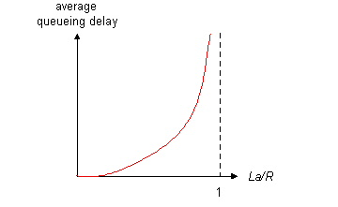

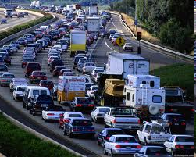
Queueing delay (revisited)
R: link bandwidth (bps)
L: packet length (bits)
a: average packet arrival rate
average queueing delay
traffic intensity
= La/R
La/R ~ 0: avg. queueing delay small
La/R -> 1: avg. queueing delay large
La/R > 1: more “work” arriving
than can be serviced, average delay infinite!
La/R ~ 0
La/R -> 1
* Check online interactive animation on queuing and loss

Slide 56
“Real” Internet delays and routes
what do “real” Internet delay & loss look like?
traceroute program: provides delay measurement from source to router along end-end Internet path towards destination. For all i:
sends three packets that will reach router i on path towards destination
router i will return packets to sender
sender times interval between transmission and reply.
3 probes
3 probes
3 probes

Slide 57
“Real” Internet delays, routes
traceroute: gaia.cs.umass.edu to www.eurecom.fr
3 delay measurements from
gaia.cs.umass.edu to cs-gw.cs.umass.edu
1 cs-gw (128.119.240.254) 1 ms 1 ms 2 ms
2 border1-rt-fa5-1-0.gw.umass.edu (128.119.3.145) 1 ms 1 ms 2 ms
3 cht-vbns.gw.umass.edu (128.119.3.130) 6 ms 5 ms 5 ms
4 jn1-at1-0-0-19.wor.vbns.net (204.147.132.129) 16 ms 11 ms 13 ms
5 jn1-so7-0-0-0.wae.vbns.net (204.147.136.136) 21 ms 18 ms 18 ms
6 abilene-vbns.abilene.ucaid.edu (198.32.11.9) 22 ms 18 ms 22 ms
7 nycm-wash.abilene.ucaid.edu (198.32.8.46) 22 ms 22 ms 22 ms
8 62.40.103.253 (62.40.103.253) 104 ms 109 ms 106 ms
9 de2-1.de1.de.geant.net (62.40.96.129) 109 ms 102 ms 104 ms
10 de.fr1.fr.geant.net (62.40.96.50) 113 ms 121 ms 114 ms
11 renater-gw.fr1.fr.geant.net (62.40.103.54) 112 ms 114 ms 112 ms
12 nio-n2.cssi.renater.fr (193.51.206.13) 111 ms 114 ms 116 ms
13 nice.cssi.renater.fr (195.220.98.102) 123 ms 125 ms 124 ms
14 r3t2-nice.cssi.renater.fr (195.220.98.110) 126 ms 126 ms 124 ms
15 eurecom-valbonne.r3t2.ft.net (193.48.50.54) 135 ms 128 ms 133 ms
16 194.214.211.25 (194.214.211.25) 126 ms 128 ms 126 ms
17 * * *
18 * * *
19 fantasia.eurecom.fr (193.55.113.142) 132 ms 128 ms 136 ms
trans-oceanic
link
* means no response (probe lost, router not replying)
* Do some traceroutes from exotic countries at www.traceroute.org

Slide 58
Packet loss
queue (aka buffer) preceding link in buffer has finite capacity
packet arriving to full queue dropped (aka lost)
lost packet may be retransmitted by previous node, by source end system, or not at all
buffer
(waiting area)
A
packet being transmitted
B
packet arriving to
full buffer is lost
* Check out the Java applet for an interactive animation on queuing and loss

Slide 59
Throughput
throughput: rate (bits/time unit) at which bits transferred between sender/receiver
instantaneous: rate at given point in time
average: rate over longer period of time
server, with
file of F bits
to send to client
link capacity
R_{s} bits/sec
link capacity
R_{c} bits/sec
server sends bits
(fluid) into pipe
pipe that can carry
fluid at rate
R_{s} bits/sec)
pipe that can carry
fluid at rate
R_{c} bits/sec)

Slide 60
Throughput (more)
R_{s} < R_{c} What is average end-end throughput?
R_{s} bits/sec
R_{c} bits/sec
R_{s} > R_{c} What is average end-end throughput?
R_{s} bits/sec
R_{c} bits/sec
bottleneck link
link on end-end path that constrains end-end throughput

Slide 61
Throughput: Internet scenario
per-connection end-end throughput: min(R_{c},R_{s},R/10)
in practice: R_{c} or R_{s} is often bottleneck
R_{s}
R_{s}
R_{s}
R
R_{c}
R_{c}
R_{c}
10 connections (fairly) share backbone bottleneck link R bits/sec
* Check out the online interactive exercises for more examples: http://gaia.cs.umass.edu/kurose_ross/interactive/

Slide 62
References
Behrouz A. Forouzan, Data Communications and Networking with TCP/IP Protocol Suite, Sixth Edition TMH, 2022

